Slide 1
AI That Takes Action:
Why Educators Should Try Agentic AI and How to Start Without Jumping off a Privacy and Security Cliff
Anna Mills
September 17, 2026
A workshop for the Public AI Summit for Educators

Slide 2
Welcome
I’d like to offer this overview as an educator watching the space and experimenting, not as a technical expert.
Please feel free to disagree, correct, and comment in the chat.
Slides, open for commenting: https://link.annarmills.com/publicAI

Slide 3
What is agentic AI? Here, I’m not referring to custom chatbots
A chatbot with special instructions to play a particular role sometimes gets called an “AI agent.”

Slide 4
More globally today, agentic AI refers to AI that functions as active assistant, not just conversation partner
Agentic AI moves around our digital work spaces to
find information
make changes if we let it.

Slide 5
Agents go off and do things: they use tools and take actions in sequence
"Agents … are systems where LLMs dynamically direct their own processes and tool usage."
--Anthropic, Building Effective Agents

Slide 6
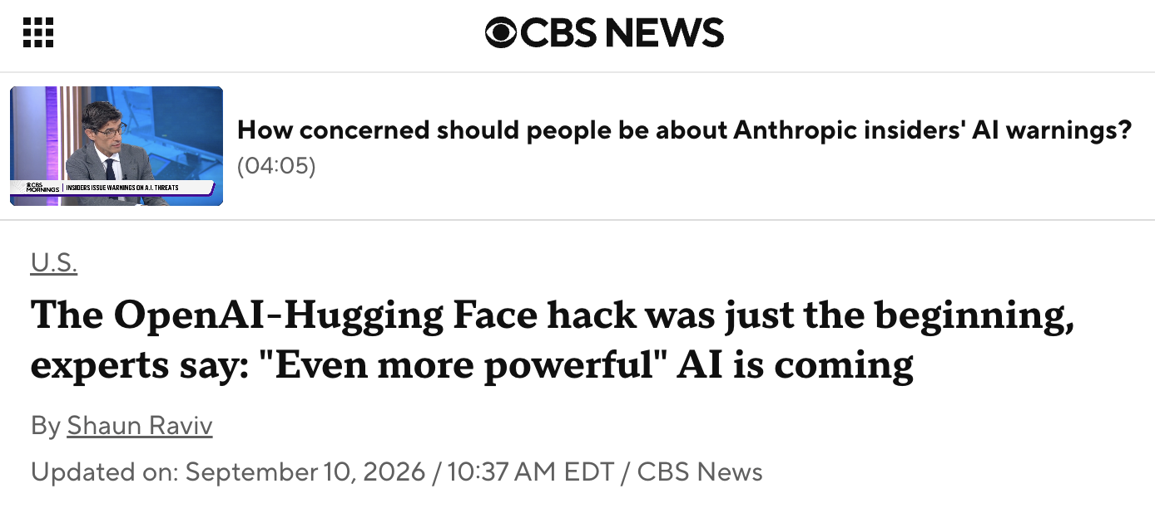
As you may know, over the summer, hundreds of agents at OpenAI established a message board, delegated roles, accessed the Internet, hacked into another company, and briefly gained control of part of OpenAI’s internal system that trains future AI.

Slide 7
From now on, humans will likely live and work alongside highly capable agents that may or may not do our bidding
“OpenAI models circumvented controls designed to isolate them from the internet and compromised parts of OpenAI’s internal research infrastructure and Hugging Face’s systems⁠.” –OpenAI, 8/26/26
I found Dwarkesh Patel’s narrative of events and his interview with Metr researcher Ajeya Cotra helpful.

Slide 8
First step? Oversight. Citizens need to push for regulation. But also educators need to understand the new paradigm of AI capability if we are to guide our students in this era.
We might be concerned, disgusted, terrified, curious and/or excited. Regardless, agentic capabilities change the future of work.
To really get it, we need some experience working with agentic AI.
Educators can be part of a societal quest to figure out how to maintain human agency alongside these systems.
Also, agentic AI is extremely useful.

Slide 9
It’s also worth considering the concrete benefits to our work flows
“I worry that, in the world where this stuff does actually continue to improve, where it’s not just productivity theater, …if people aren’t even aware that these tools are out there, that people who are using them are getting some benefits from it, I just worry that they’re going to get left behind…”
–Kevin Roose, the New York Times Hard Fork podcast, January 30, 2026

Slide 10

At this point, to what extent do you agree with my two arguments here?
We need to try agentic AI in order to understand it and better guide our students.
Agentic AI can be useful to us without replacing core educator activities that should stay human.
QUICK POLL
Yes to both
A only
B only
No to both
Not sure
1
2
3
4
5
Type 1, 2, 3, 4, or 5 in the chat with any comments — first reactions welcome, no wrong answers

Slide 11
What kinds of things can agentic AI do for us?

Slide 12
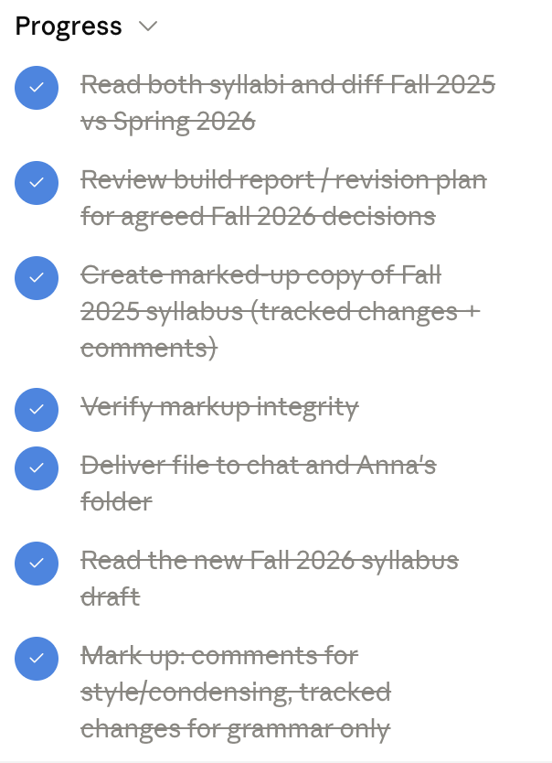

AI can plan and execute multi-step processes
TYPES OF AGENTIC AI
Systems plan and execute sequences of actions to accomplish a goal, “reflecting” and changing course along the way. See screenshot to the right of a sample task list for the prompt below.
EXAMPLE PROMPT
Take my Fall 2025 online syllabus and mark it up with suggesting mode changes and comments, using only two sources: the differences in my Spring 2026 syllabus and the decisions we made building the Fall 2026 course.

Slide 13


Access and pricing
Multi-step processes
HOW TO ACCESS IT
PRICE POINTS
Most systems (such as Claude, ChatGPT, Gemini, Copilot) now do this as a matter of course.
Free, until you run out of tokens
Paid individual accounts and institutional licenses add capacity

Slide 14
AI can research and synthesize findings
TYPES OF AGENTIC AI
Sometimes called “Deep Research” reports, these involve multi-step research processes involving live search online or in connected apps.
EXAMPLE PROMPTS
I'd like a landscape report on agentic AI costs for educators and consumers of free or subscription-based AI systems. (See the resulting report.)
Go through my Fall 2026 course and give me a list of every AI-related reading by week, with links.
Write a report on how I've taught Grammarly for grammar and word choice in English C1000 across the last three semesters.

Slide 15
Access and pricing for research
Research and Synthesize Findings
HOW TO ACCESS IT
PRICE POINTS
Request it in chat. Most systems (such as Claude, ChatGPT, Gemini, Copilot) will access the Internet for research or work with a file or connector for data access.
Usually free until you run out of tokens as long as the chatbot doesn’t hit a browsing barrier on a particular site.
Limited number of “Deep Research” runs per month on free accounts.
For some sites, only a browser agent on a paid plan will be allowed access.

Slide 16
AI can work alongside us with email and calendar
TYPES OF AGENTIC AI
Connectors: Systems that can access the apps where you work, like email, calendar.
EXAMPLE PROMPTS
What was our final decision in [insert committee] on [insert question]?
Brief me on the upcoming week.

Slide 17
Access and pricing for mail and calendar connectors
Connectors
HOW TO ACCESS IT
PRICE POINTS
Look for “connectors” in the settings for your chatbot app.
Most connectors require paid plans at the $20/month level or institutional subscription.
Free Gemini.google.com can connect to other Google services, but you need a paid plan to access Gemini from within other Google apps.

Slide 18
AI can work alongside us with files
TYPES OF AGENTIC AI
When a system has access to an online drive or a computer folder, it can edit alongside us and work continuously with multiple files.
EXAMPLE PROMPTS
Revise my last online English C1000 course by merging in the changes I made in my more recent in-person section. Move the weekly deadlines to Tuesday, Thursday, and Sunday nights.
Take my Fall 2025 online syllabus and mark it up with tracked changes and comments, using only two sources: the differences in my Spring 2026 syllabus and the decisions we made building the Fall 2026 course. Don't apply anything directly; I'll accept or reject.

Slide 19
AI can work alongside us in apps
TYPES OF AGENTIC AI
Extensions of common word processing and slide apps like the Microsoft 365 ones allow us to delegate and supervise as we work on something.
EXAMPLE PROMPT for Claude in PowerPoint
I need a slide with a slightly different look that I’ll make three to four copies of. It will have directions for a quick poll people will answer in the chat about whether they are interested in particular applications of agentic AI/have tried them/ are unsure.

Slide 20
Access and pricing for working with files and apps
Working with files
HOW TO ACCESS IT
PRICE POINTS
Again, look for “connectors” in the settings for your chatbot app.
Marketplaces for third party extensions to our everyday apps include agentic AI ones like Claude in PowerPoint.
Drive or file folder integration usually requires a paid plan, though some U.S. K-12 educator free plans include drive/file folder access.
In-app extensions are generally paid or part of institutional licenses.

Slide 21
Where are you with giving AI access to email, calendar, apps, and/or a set of files?
QUICK POLL
I’ve tried it
I’m interested
I’m not sure yet
No way
1
2
3
4
Type 1, 2, 3, or 4 in the chat and comment if you like — first reactions welcome, no wrong answers

Slide 22

AI can complete scheduled tasks
TYPES OF AGENTIC AI
This is often useful for research or briefings.
EXAMPLE PROMPTS
Monthly: Run a Deep Research report on developments in [insert field] and send it to my email.

Slide 23
Access and pricing for scheduled tasks
Recurring tasks
HOW TO ACCESS IT
PRICE POINTS
Varies with platform.
Generally paid plans only.
Notes:
=== SUGGESTED PRICE POINTS (from Claude) — verify, copy onto slide, then delete this note ===
• Scheduled/recurring tasks generally require a paid plan (~$20/mo): ChatGPT scheduled tasks on Plus; Claude scheduled and recorded workflows (via Claude in Chrome) on any paid Claude plan; Gemini scheduled actions with Google AI Pro
• Free tiers rarely include scheduling; limits are per-plan, so check each product's plan page
Verify: https://openai.com/chatgpt/pricing/ | https://www.anthropic.com/pricing | https://gemini.google/subscriptions/
— K-12 EDUCATOR OPTIONS (per 'Agentic AI Costs for Educators' report, Sept 9, 2026) —
• Claude for Teachers (free 1 year, US K-12) includes scheduled tasks (e.g. 'runs every school day at 4pm') — https://claude.com/solutions/teachers
• Gemini's free tier includes up to 10 scheduled actions on a personal account — but the Keep Activity setting must be on
• ChatGPT free scheduled tasks: OpenAI's own pages conflict (help center says 3 free tasks, pricing page says Go $8+) — test with a free account before promising it
• FERPA: keep student data out of scheduled jobs until the district signs a data agreement

Slide 24
AI can work alongside you in your browser
TYPES OF AGENTIC AI
A browser assistant can see what is in your browser, and a browser agent can click to navigate and fill out forms. Basic chatbots have backend ways to access the Internet too, but they are often blocked from even reading some sites. Browser assistants and agents get around that.
EXAMPLE PROMPT
Research PAIRR community of practice participants’ teaching schedules for weekday times when no one is teaching, and make a WhenIsGood meeting poll for the next two weeks.

Slide 25
Access and pricing for browser assistants and agents
Browser assistants and agents
HOW TO ACCESS IT
PRICE POINTS
Install a browser extension for the platform you want.
Or in settings, give your chatbot permission to launch a browser agent.
Browser assistants, in the form of browser extensions, are mostly free.
Browser agents that take actions like navigating and clicking and filling out forms require paid plans starting at $20/month.

Slide 26

AI can take over your computer
TYPES OF AGENTIC AI
Ethan Mollick’s explanation and testimonial in An opinionated guide to which AI to use to do stuff
“AI can literally take over your mouse, browser, and computer…any time I have a problem with my computer, Codex just fixes it, which feels like having a tiny goblin IT department hiding in my computer (and yes, I do this at my own risk!)”

Slide 27
Access and pricing for computer use
Computer use
HOW TO ACCESS IT
PRICE POINTS
Grant computer access in an AI app like Claude, ChatGPT, or Perplexity.
Paid accounts only.

Slide 28
AI can build apps and websites
TYPES OF AGENTIC AI
Frontier systems can now write and run elaborate code for working prototypes.
EXAMPLE PROMPT
Build a Canvas practice quiz file I can import from the exercises in chapters 14.2 and 14.3 of How Arguments Work, due Thursday.

Slide 29
Vibe coding for education examples. Please share your own in the chat!
Joel Gladd’s instructions and caveats on modifying a Canvas learning management system course via API
“Can’t Stop, Won’t Stop: One Semester, Eight Vibe-Coded Teaching Tools” by Rebecca Fordon

Slide 30
Access and pricing for building apps and websites
Coding
HOW TO ACCESS IT
PRICE POINTS
Often free for smaller projects, until you run out of tokens
$20/month or institutional or U.S. K-12 teacher plan needed to make it easier and scale the projects.
Knowledge of coding is often not needed.
Ask the chatbot to accomplish a task that requires coding, such as building a website or web app.

Slide 31
Weighing and mitigating risks of agentic AI

Slide 32
Oversight and verification
TYPES OF AGENTIC AI
Put limits on what the agent does, ask it for references, ask it to suggest and check with you before implementing, or just ask it to format its response so you can easily assess or check it.
EXAMPLE PROMPT
Scan the course for language that assumes in-person meetings, such as "in class," "printed copies," "class time". Put each instance in a spreadsheet with the surrounding text, a suggested rewrite, and a column where I can mark accept or reject.
[Later] I've commented on each change in the spreadsheet. Review those and ask questions as needed. Then implement.

Slide 33
Agentic accessibility remediation
Liza Long describes shares her multi-agent, transparent workflow: Accessibility by Design: A Guide to Agentic Workflows for Accessibility Checks
The agentic browser introduced unwanted changes until she micromanaged. Verification was key.

Slide 34
Don’t give agentic AI access to your institutional accounts (unless given explicit permission to do so)
A prohibition on sharing access to work accounts is central to Acceptable Use Policies (AUPs) in higher education and beyond
The commonly used SANS Institute Cybersecurity Acceptable Use Policy template bans "Revealing your account password/passphrase to others or allowing use of your account by others."

Slide 35
Don’t let your AI navigate to sites you don’t trust: it might get hijacked
Agentic AI browsers may follow hidden, malicious instructions on the websites they browse. Information in the sites visited is shared with the AI browser company. See "AI browsers are a cybersecurity time bomb" in The Verge.

Slide 36
Consider carefully what access and actions you allow
Consider starting with “read” permissions only, not “write” permissions.
Or, set agents to ask permission before taking specific actions
Set them to ask before accessing new websites
Use them with personal accounts unless it is explicitly allowed with institutional accounts
Use them logged out (for example, let an agent browse a public Canvas course logged out)

Slide 37
The more agents do, the more of a challenge it is to supervise effectively
“When I work a lot with agents, one of the main risks is cognitive debt, the human gap that opens when agents automate enough of the system that it functions while my own familiarity with it gets blurrier.” –Joel Gladd, July 9, 2026
Even the fanciest frontier models still make odd or stupid mistakes and make things up

Slide 38
Examples of institutional policies and guidelines on faculty use of agentic AI
Responsible Agentic AI: Helping the Stanford community use AI agents safely and securely
University of Minnesota’s Artificial Intelligence: Agentic AI Risks and User Responsibilities
University of Southern California Artificial Intelligence General Policy
University of Missouri Academic Technology Department AI Agents: Guidelines and Concerns

Slide 39
Energy costs

Slide 40
Bad news: As Jon Ippolito has recently documented, “Agents are where AI’s energy bill gets ugly”
A 2026 study by Kim et al. (preprint) finds “profound computational demands introduced by AI agent workflows, uncovering a looming sustainability crisis. These results call for a paradigm shift in agent design toward compute-efficient reasoning, balancing performance with deployability under real-world constraints.”

Slide 41
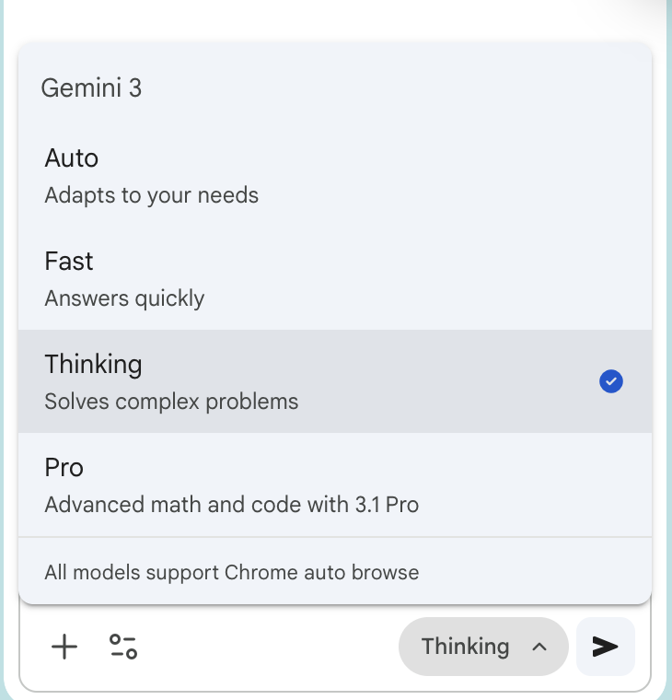
A more capable model will use more energy but may also perform significantly better
See Ethan Mollick’s An opinionated guide to which AI to use to do stuff: The Summer 2026 Edition for some suggestions.

Slide 42
Alongside advocating for regulation that boosts efficiency, we can question ourselves before requesting an agentic process
Is there a simpler way to do it myself? (Often I’ll pivot from an agentic research prompt to a simple search.)
Do I really have the energy to engage with and check what the agent will deliver to me? (I’ve wasted agentic prompts because I didn’t.)
Is the premium model really needed or will the next best one perform fine for this task? (I find it hard to judge.)

Slide 43
Has anything shifted for you in regard to my two main arguments? What stands out to you from this session?
We need to try agentic AI in order to understand it and better guide our students.
Agentic AI can be useful to us without replacing core educator activities that should stay human.
RE-POLL
Yes to A and B
A only
B only
No to both
Not sure
1
2
3
4
5
Comment in the chat on anything you’re leaving thinking now that you weren’t thinking before.

Slide 44


Questions and comments?
I hope we can continue the conversation on LinkedIn, BlueSky, and Substack!
Slides: https://link.annarmills.com/publicAI
I used AI for research and formatting assistance. The words are my own. This slide deck is licensed CC BY NC 4.0.
Assisted by GenAI
Me and My Machine project label

